Slide 1
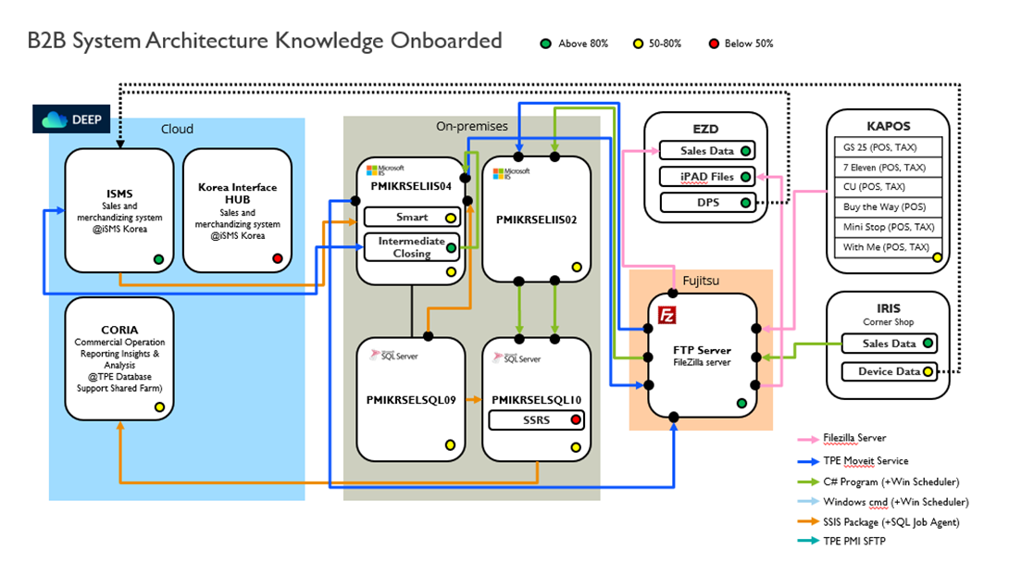
AS - IS
UDIST
moveit
메가존
BASIC
Notes:
2 : C#
4 :

Slide 2

TO - BE
Cloud DataBase
Scheduler
Shared Folder
AWX
(SSIS & T-SQL)
DWH32
(SQL10)
Source File
ISMS
txt, csv, xml, dat
DWH31
(SQL09)
( KAPOS, KATAX, SIS, IRIS, EPSCONTRACT, 3PEcom, Ecomm )
Target File
pmisapgmp01
CORIA
UDIST.txt
EZD

Slide 3
최종ver

Slide 4
TO - BE
Cloud DataBase
Scheduler
Shared Folder
AWX
(SSIS & T-SQL)
DWH32
(SQL10)
Source File
ISMS
txt, csv, xml, dat
DWH31
(SQL09)
Target File
pmisapgmp01
CORIA
UDIST.txt

Slide 6
AS - IS

Slide 7
TO - BE
Cloud DataBase
Scheduler
Shared Folder
AWX
(SSIS & T-SQL)
CORIA
Source File
ISMS
DWH31
(SQL09)
DWH32
(SQL10)
txt, csv, xml, dat
Target File
pmisapgmp01
UDIST.txt

Slide 8
TO - BE
Cloud DataBase
Scheduler
Shared Folder
AWX
(SSIS & T-SQL)
DWH32
(SQL10)
Source File
ISMS
txt, csv, xml, dat
DWH31
(SQL09)
Target File
pmisapgmp01
CORIA
UDIST.txt

Slide 9
TO - BE
Cloud DataBase
Scheduler
Shared Folder
AWX
(SSIS & T-SQL)
DWH32
(SQL10)
Source File
ISMS
txt, csv, xml, dat
DWH31
(SQL09)
Target File
pmisapgmp01
CORIA
UDIST.txt

Slide 10
TO - BE
Cloud DataBase
Scheduler
Shared Folder
AWX
(SSIS & T-SQL)
DWH32
(SQL10)
Source File
ISMS
txt, csv, xml, dat
DWH31
(SQL09)
Target File
pmisapgmp01
CORIA
UDIST.txt

Slide 12
TO - BE
Cloud DataBase
Scheduler
Shared Folder
AWX
(SSIS & T-SQL)
DWH32
(SQL10)
Source File
ISMS
txt, csv, xml, dat
DWH31
(SQL09)
Target File
pmisapgmp01
CORIA
UDIST.txt

Slide 13
TO - BE
Cloud DataBase
Scheduler
Shared Folder
AWX
(SSIS & T-SQL)
DWH32
(SQL10)
Source File
ISMS
txt, csv, xml, dat
DWH31
(SQL09)
Target File
pmisapgmp01
CORIA
UDIST.txt

Slide 14
TO - BE
Cloud DataBase
Scheduler
Shared Folder
AWX
(SSIS & T-SQL)
ISMS
DWH32
(SQL10)
Source File
txt, csv, xml, dat
DWH31
(SQL09)
Target File
pmisapgmp01
CORIA
UDIST.txt

Slide 15
TO - BE
Cloud DataBase
Scheduler
Shared Folder
AWX
(SSIS & T-SQL)
ISMS
DWH32
(SQL10)
Source File
txt, csv, xml, dat
DWH31
(SQL09)
Target File
pmisapgmp01
CORIA
UDIST.txt

